Slide 1
JOIN NOW
NEA-NEW HAMPSHIRE
Notes:
Welcome to Join Now - NEA-New Hampshire’s online process for enrolling new members.

Slide 2
WHAT IS JOIN NOW?
Online enrollment for new members
User-friendly process using any device with an internet connection
No paper form required
Access Join Now:
Text Join to 48744
Scan the QR Code
Enter the direct URL: https://join.nea.org/new-hampshire/
Visit our website: https://neanh.org/
Notes:
Join Now is easy, user-friendly, and requires no paper enrollment form. The new member will be automatically enrolled into our membership system and a copy of the new member’s enrollment information will be forwarded to the local. Eventually we would love to see all new members join through Join Now, but your local can continue to use paper forms if you choose – we won’t be taking that option away. Join Now is another tool to help you in your membership recruitment efforts.
There are several easy options for accessing Join Now: Text Join to 48744; Scan the QR code; enter the URL for the direct Join Now link; or click on the Join Now banner from the NEA-NH website: https://neanh.org/

Slide 3
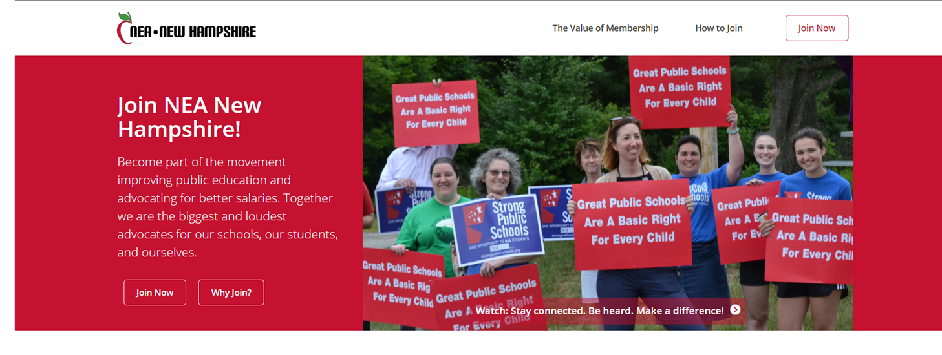
Notes:
On the Join Now landing page, the new member will find information about the value of membership. When they are ready to join, click “Join Now” anywhere on the page to begin the application.

Slide 4
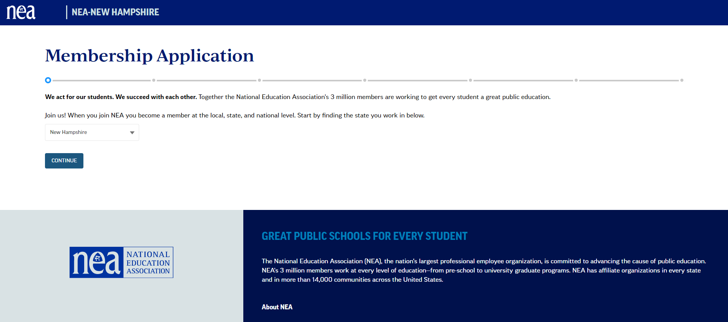
SELECT NEW HAMPSHIRE
Notes:
Start by selecting the state. Find New Hampshire by scrolling through the list or just start typing and it will automatically populate. Click the blue “CONTINUE” button.

Slide 5
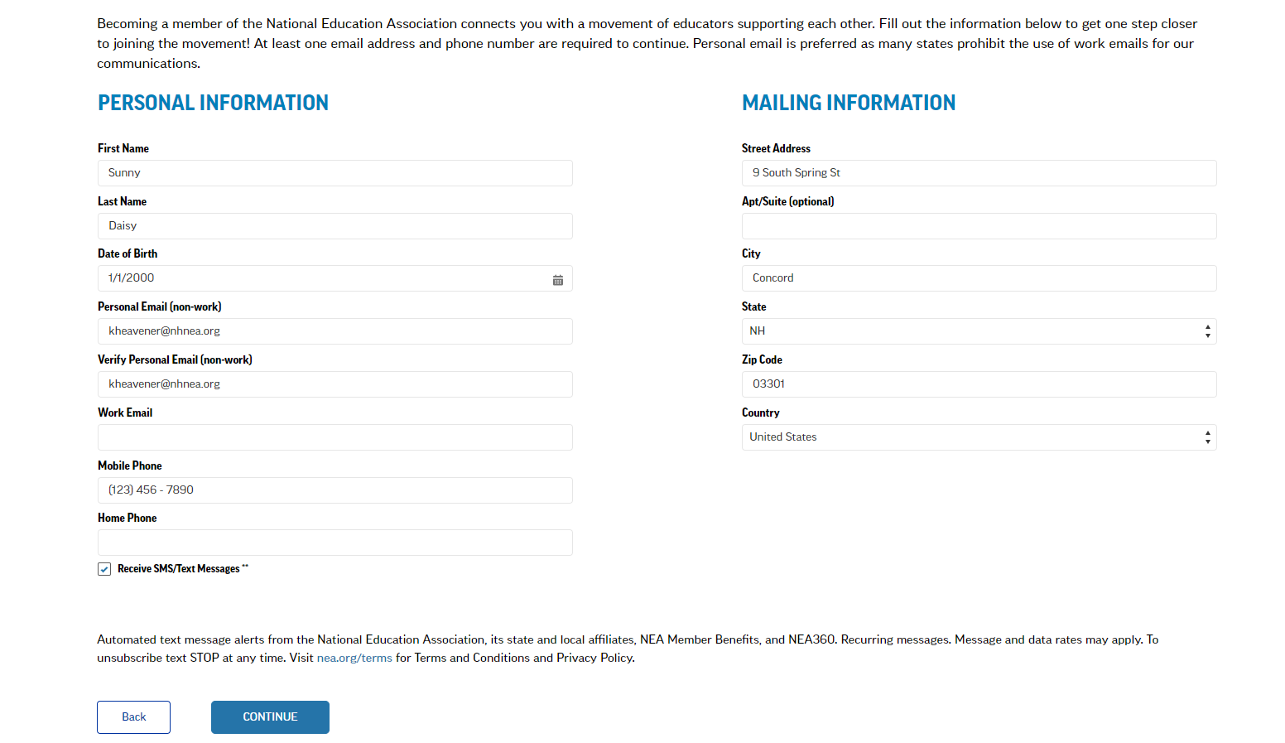
COMPLETE YOUR CONTACT INFORMATION
Notes:
The new member will fill in their contact information. The application asks for the same information as on the traditional paper membership form. To go back to a previous tab, always use the “BACK” navigation button at the bottom of each screen. Using the browser’s back arrow exits the application without saving any information. When everything looks good, click “CONTINUE.” Throughout the application process, the system will prompt for any missing information before moving to the next screen.

Slide 6
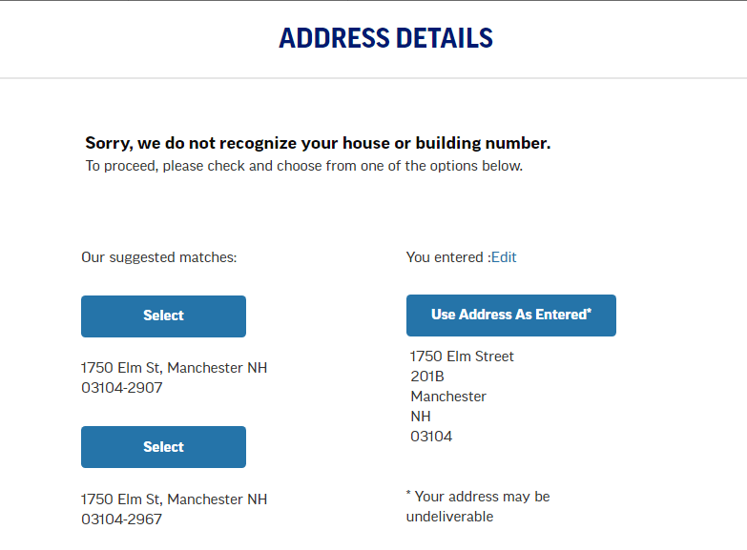
CONFIRM YOUR ADDRESS
Notes:
If the system doesn’t recognize the address as entered, the new member will be prompted to verify their address and/or House or Building Number.

Slide 7
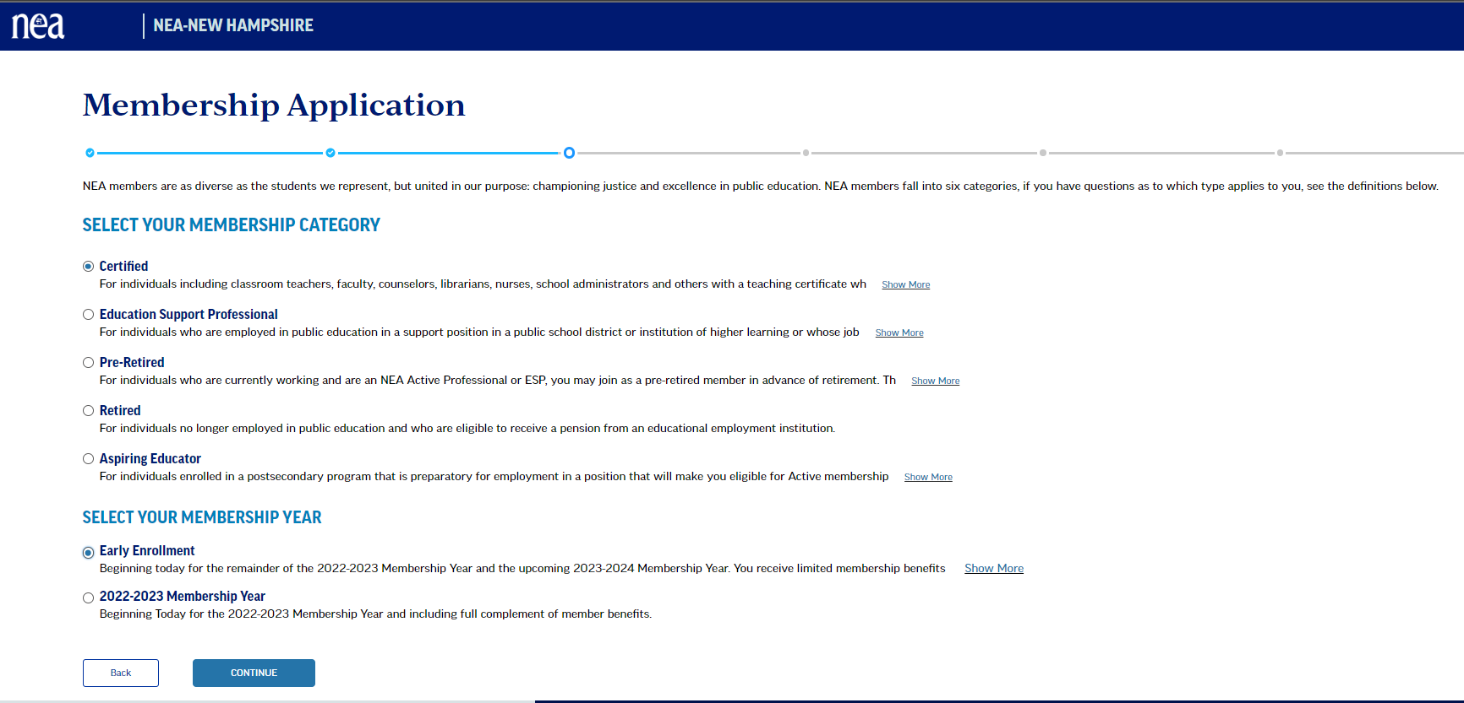
SELECT YOUR MEMBERSHIP CATEGORY
Notes:
The new member will then select their MEMBERSHIP CATEGORY. Click “Show More” for a detailed description of each category. Only Certified and ESP memberships can be processed completely through Join Now. Clicking pre-retired, retired, or aspiring educator will take the new member to a different webpage where they can find more information about joining.
Select the desired MEMBERSHIP YEAR. Choices will vary depending on time of year. For Early Enrollment, Join Now includes all pledge form language making enrollment super easy. If using paper forms for Early Enrollment, new members need to submit a membership form AND a pledge commitment form. Click “CONTINUE.”

Slide 8
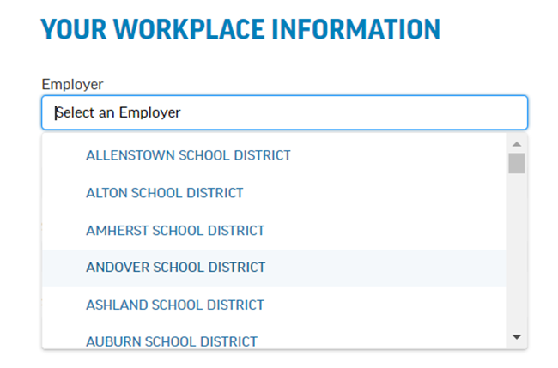
COMPLETE YOUR WORKPLACE INFO
Notes:
The new member is prompted to fill out their Workplace Information. As with the contact information, this is the same information that we ask for on the traditional paper membership form - with one exception. The new member must provide their employer information. Choosing the correct employer will help the system determine the correct local for the new member.
To select the Employer, choose from the dropdown or just start typing. After selecting the Employer, the Work Locations for that Employer are shown in the next dropdown box.

Slide 9
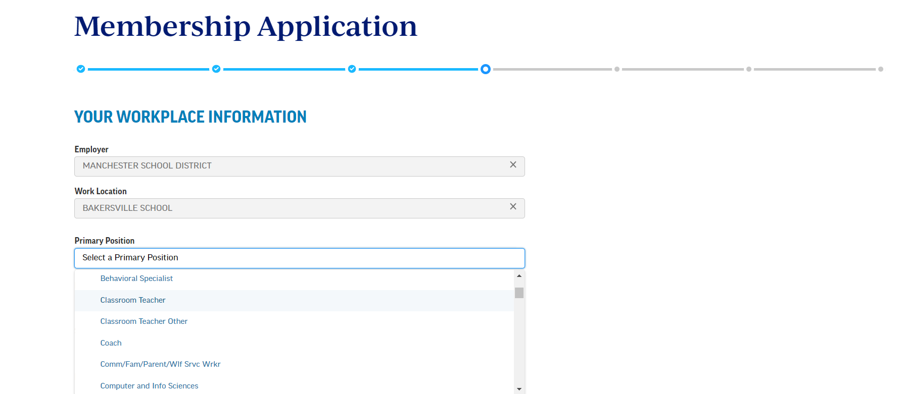
WORKPLACE POSITION CHOICES
Notes:
The new member will then select their Position. Choices will vary based on membership category selected (Certified or ESP). If the exact position isn’t listed, choose the closest match. Note the blue bar across the top of the screen. Just as with other online applications, this bar indicates the application progress.

Slide 10
HOURS WORKED AND STEP CHOICES
Step 1 = First Step on the Salary Schedule or Starting Base Wage
Step 2 = Second Step on the Salary Schedule or Second Year Negotiated Wage
Notes:
The new member will select their Hours Worked and their Step for the membership year in which they are enrolling. For example, a new member enrolling as an Early Enrollee should choose their step for the upcoming membership year.
Step 1 = First Step on the Salary Schedule or Starting Base Wage; Step 2 = Second Step on the Salary Schedule or Second Year Negotiated Wage (not first or second year in the school district or union).

Slide 11
HOURS WORKED – ESP POSITIONS
Notes:
Hours Worked choices are slightly different for the ESP membership category. Just like with the paper membership form, new ESP members may need guidance from their local leader to figure out the correct response for their situation. For example, most ESPs that work full time throughout the school year will qualify as Three Quarters Time – not Full Time. If a local leader is sending new members to Join Now, it would be helpful to tell them ahead of time what category and step they should choose.

Slide 12
OPTIONAL FIELDS
Notes:
The Hire Date and Referred By fields are not required but are useful information that we encourage new members to provide. If a new member lists someone in the referred by field, the UniServ Assistant will share that information with the local leader.

Slide 13
WORKPLACE INFORMATION
Notes:
When all required Workplace Information fields have been completed, click “Continue” to move to the next screen.

Slide 14
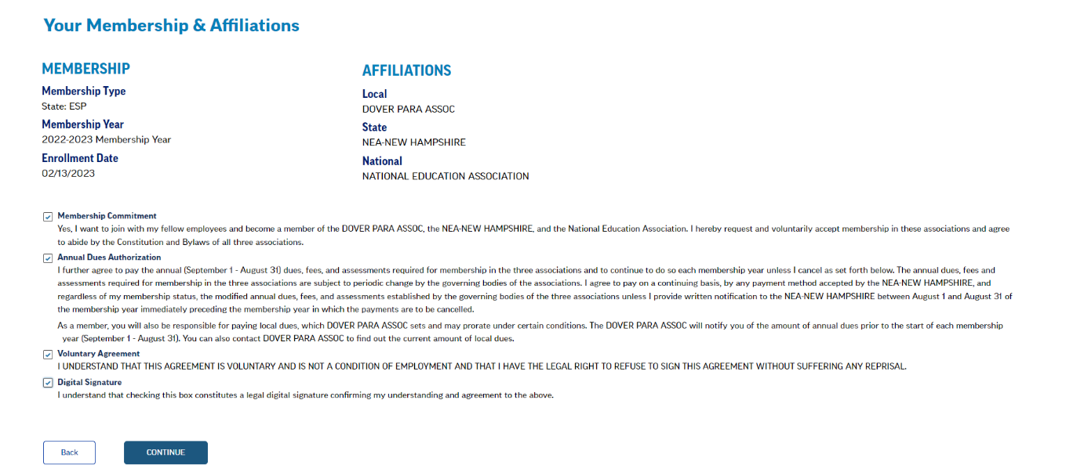
MEMBERSHIP SUMMARY
Notes:
The new member is now presented with an overview of their membership type, enrollment date, local affiliation, and disclaimers.

Slide 15
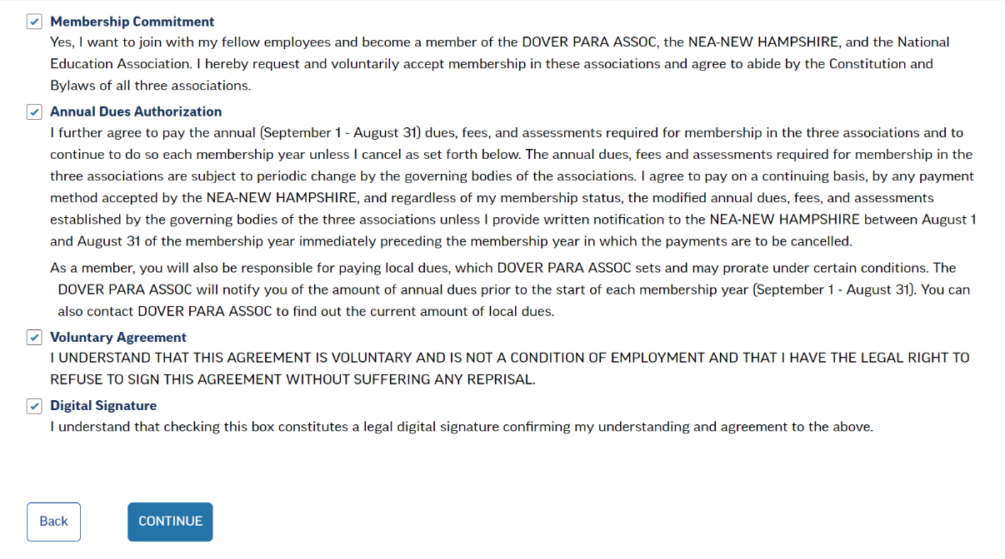
MEMBERSHIP DISCLAIMERS
YES – I WANT TO JOIN
I AGREE TO PAY THE ANNUAL DUES
I UNDERSTAND THIS AGREEMENT IS VOLUNTARY
I UNDERSTAND THIS IS MY LEGAL DIGITAL SIGNATURE
Notes:
The disclaimers contain similar language as the paper membership form: YES, I want to join; I agree to pay the annual dues; I understand this agreement is voluntary; and I understand that checking this box constitutes a legal digital signature.
An important note about local dues – Join Now does not account for local dues unless a local is set up in our system for us to collect their local dues through EasyPay. The new member is advised that they will be responsible for local dues and someone from their local will contact them. (NOTE THE HIGHLIGHTED SECTION ON THIS SCREEN). After reviewing, check all four boxes to indicate agreement and hit “Continue.”

Slide 16
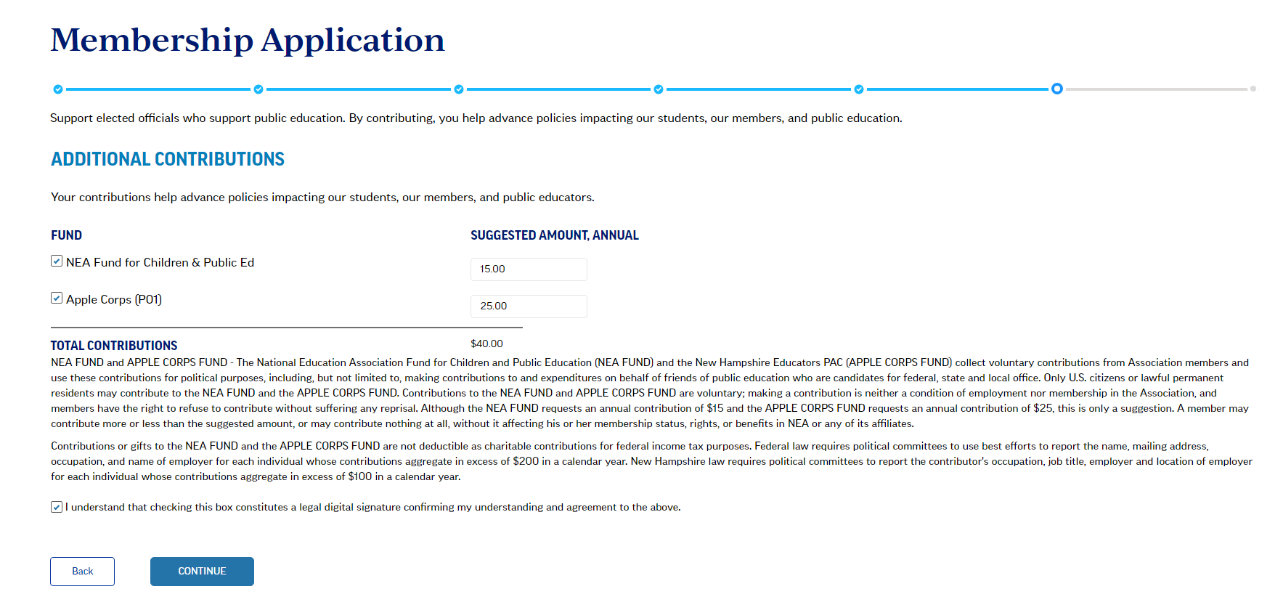
ADDITIONAL CONTRIBUTIONS
Notes:
As with the paper membership form, the new member has the option to support elected officials who support public education. These are VOLUNTARY CONTRIBUTIONS. By contributing to the NEA Fund and NEA-NH’s Apple Corps fund, the new member will help advance policies impacting our students, our members, and public education. The new member can select the checkboxes next to the funds and enter contribution amounts, if desired. Check the box to indicate agreement to the terms and click Continue. The new member can also simply click CONTINUE to skip this page.

Slide 17
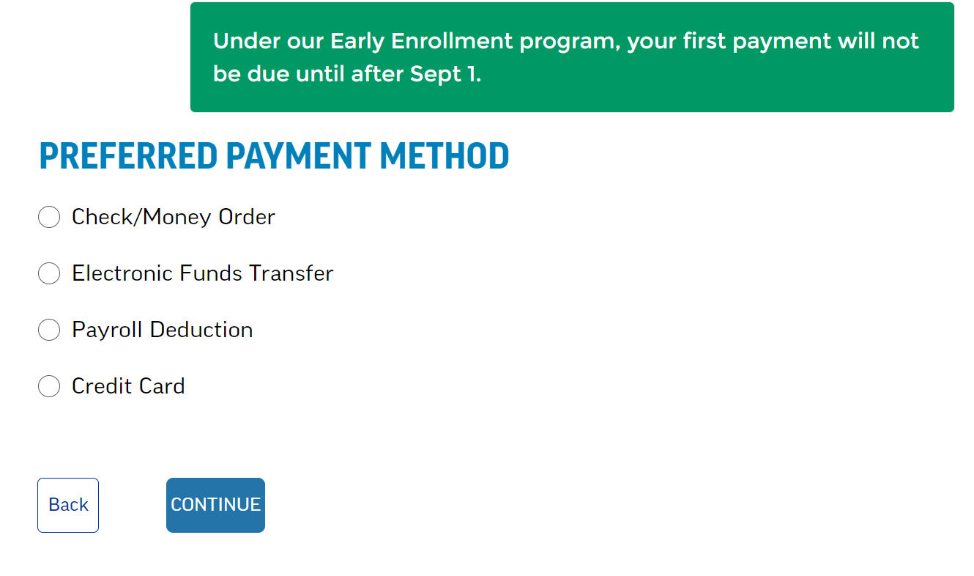
PAYMENT METHOD OPTIONS
Notes:
The new member is now given a choice of several Payment Methods. Select a payment method and hit CONTINUE to be provided with the Dues and Contributions Total as well as additional information and/or questions pertaining to that payment method choice. If the new member is enrolling as an Early Enrollee, they will see the Green Banner across the top explaining that their first payment will not be due until after September 1.

Slide 18
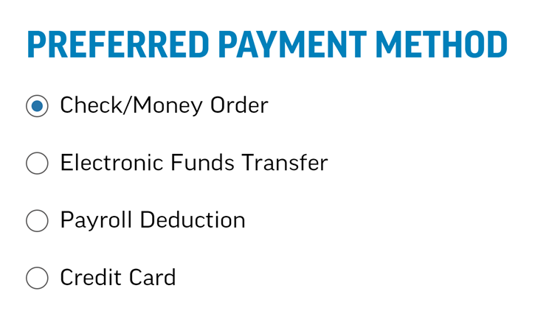
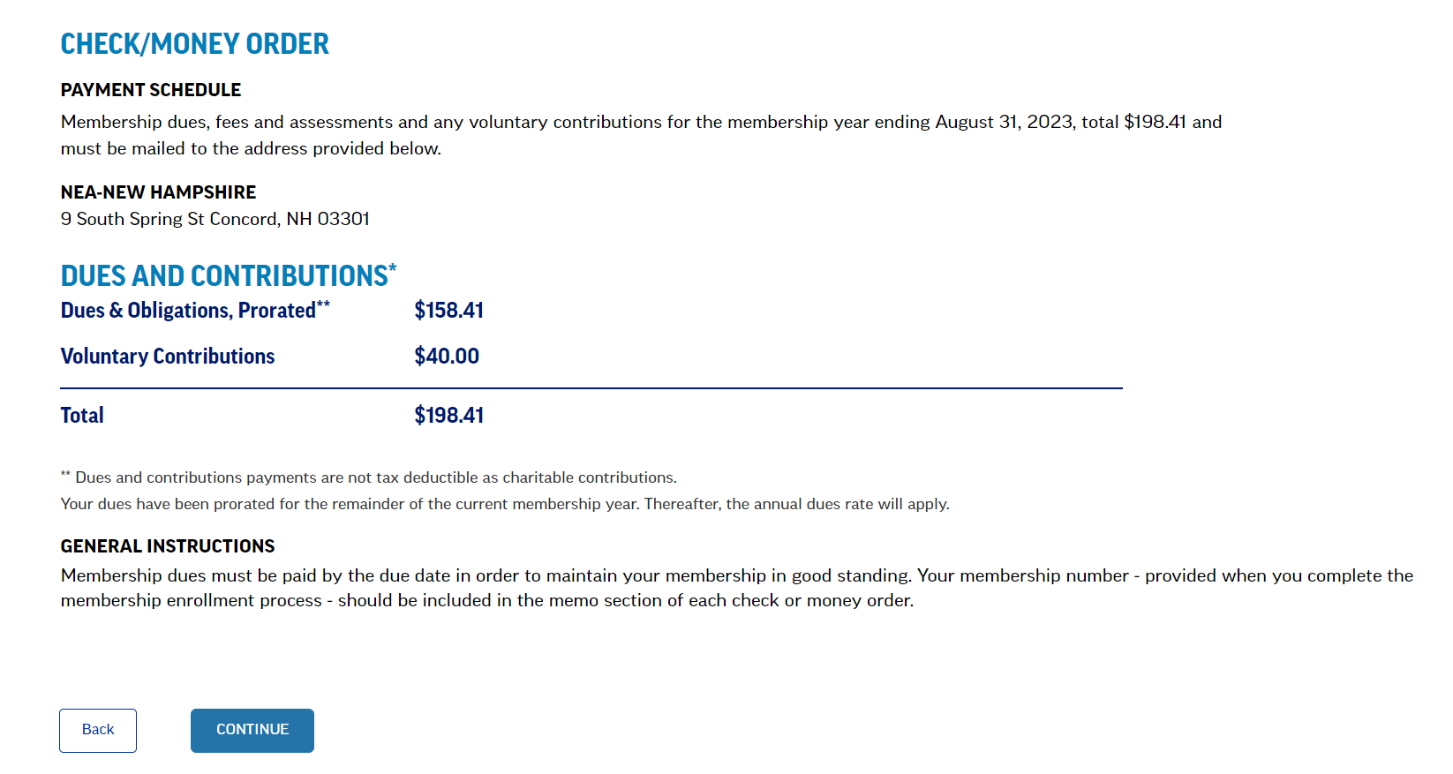
CHECK PAYMENT METHOD
Notes:
The CHECK Payment Method is for 1 payment in full. The system directs the new member to send the check to NEA-NH. However, if the new member has not already mailed the check to NEA-NH, please ask them to make the check payable to the local and submit it to your local treasurer. In this example, you’ll notice that since the new member joined on 2/13/2023, the system has automatically prorated the dues for the remainder of the 2022/2023 membership year.

Slide 19
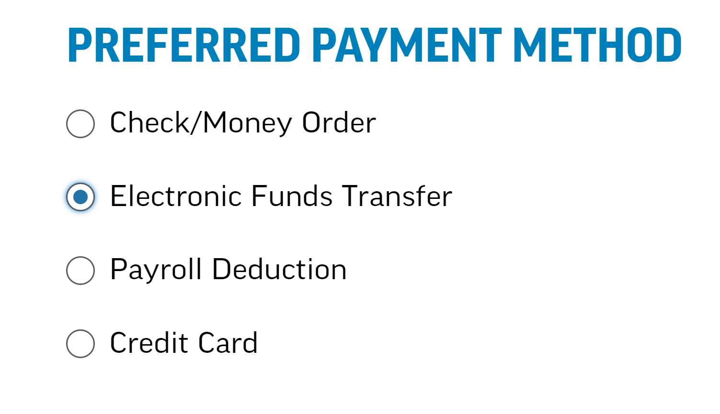
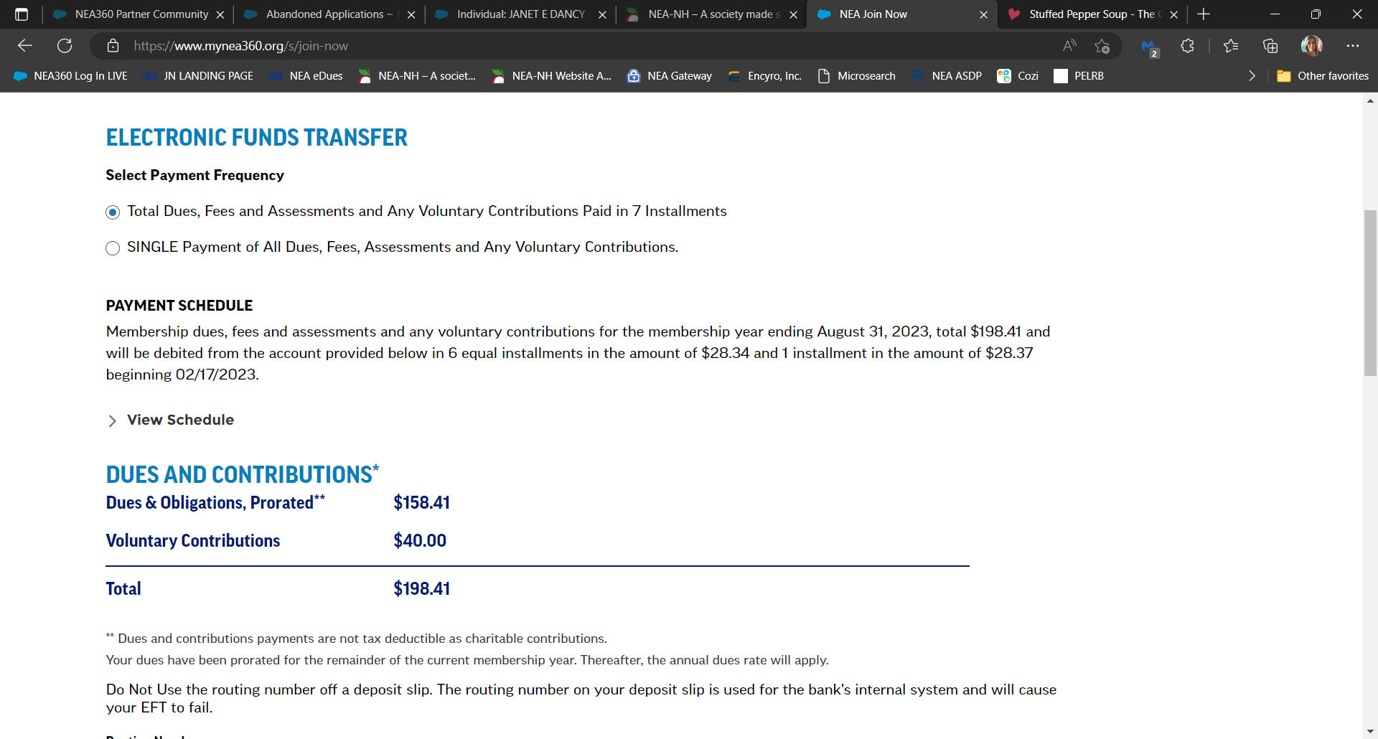
EFT PAYMENT METHOD
Notes:
The Electronic Funds Transfer Payment Method (EFT) gives the new member the choice of paying in one single payment annually from their bank account or they can spread the payments out over time.

Slide 20
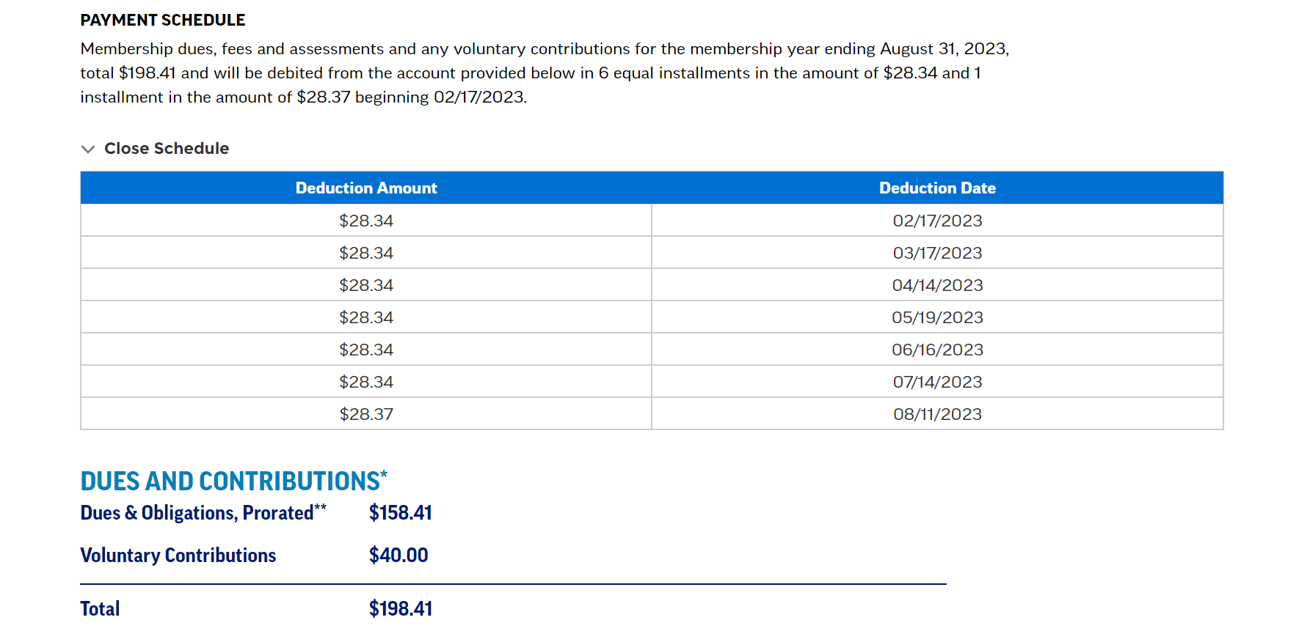
EFT PAYMENT METHOD: VIEW EFT SCHEDULE
Notes:
If spreading out payments, the new member can click VIEW SCHEDULE to see the deduction schedule. If the local is set up for EasyPay, there will be a specific deduction schedule over the course of the school year; if they are not set up for EasyPay, their deductions will be spread out over 12 months. In this example, the new member joined on 2/13/2023 and has 7 payments remaining for the 2022/2023 membership year.

Slide 21
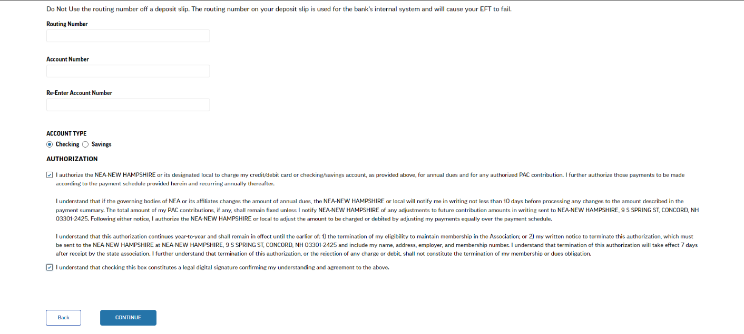
EFT PAYMENT METHOD: ENTER BANKING INFORMATION AND AUTHORIZE DEDUCTIONS
Notes:
The new member is prompted to enter their banking information and account type. Check the disclaimer boxes to authorize the deductions from the Checking or Savings account and hit CONTINUE. There are similar disclaimers for all payment methods.

Slide 22
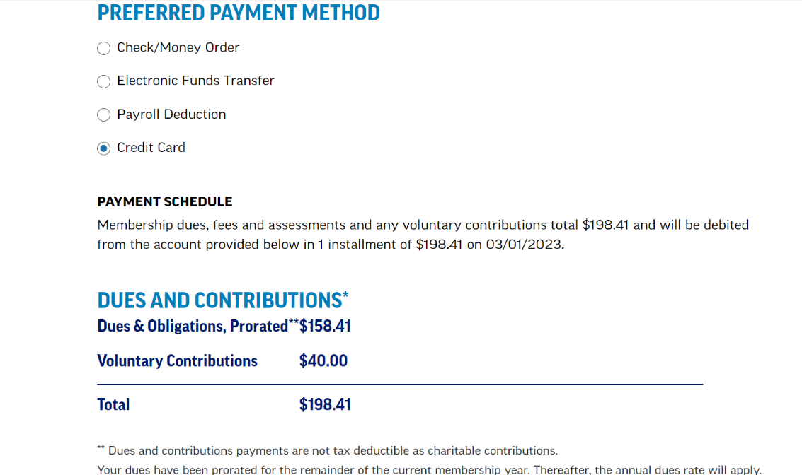
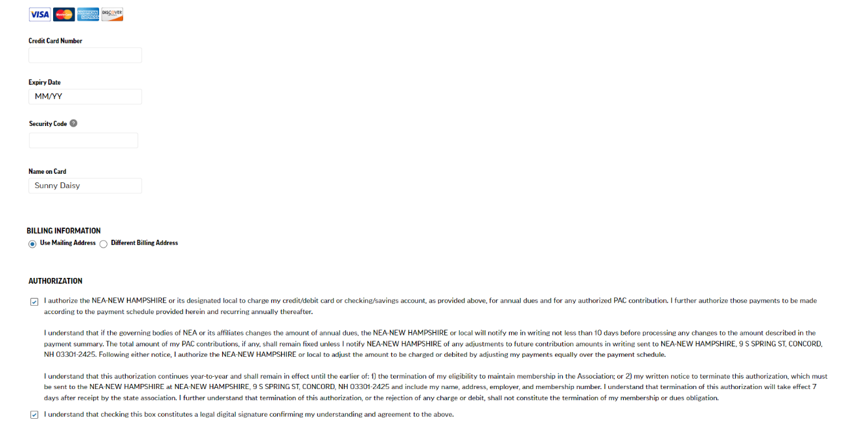
CREDIT CARD PAYMENT METHOD
Notes:
The CREDIT CARD Payment Method is similar to EFT except there is only one annual payment in full. The new member will enter their card information here, but their card will not be charged until the beginning of October. If a member joins mid-year like in this example, their card will be charged at the beginning of the month following the date they join. The authorization box explains that this charge continues year-to-year.

Slide 23
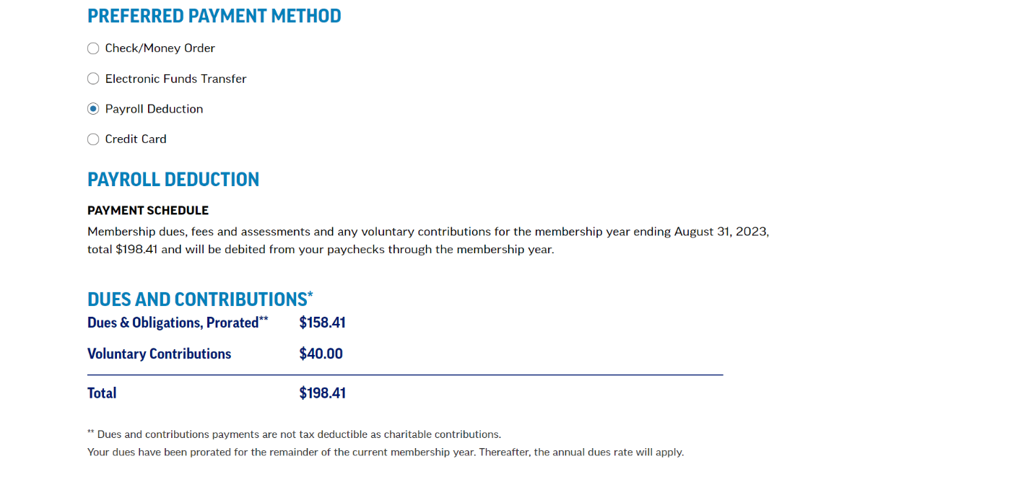
PAYROLL DEDUCTION PAYMENT METHOD
Notes:
PAYROLL DEDUCTION is also an available payment method choice. If your local does NOT offer payroll deduction, be sure to tell your new member to select a different payment method.

Slide 24
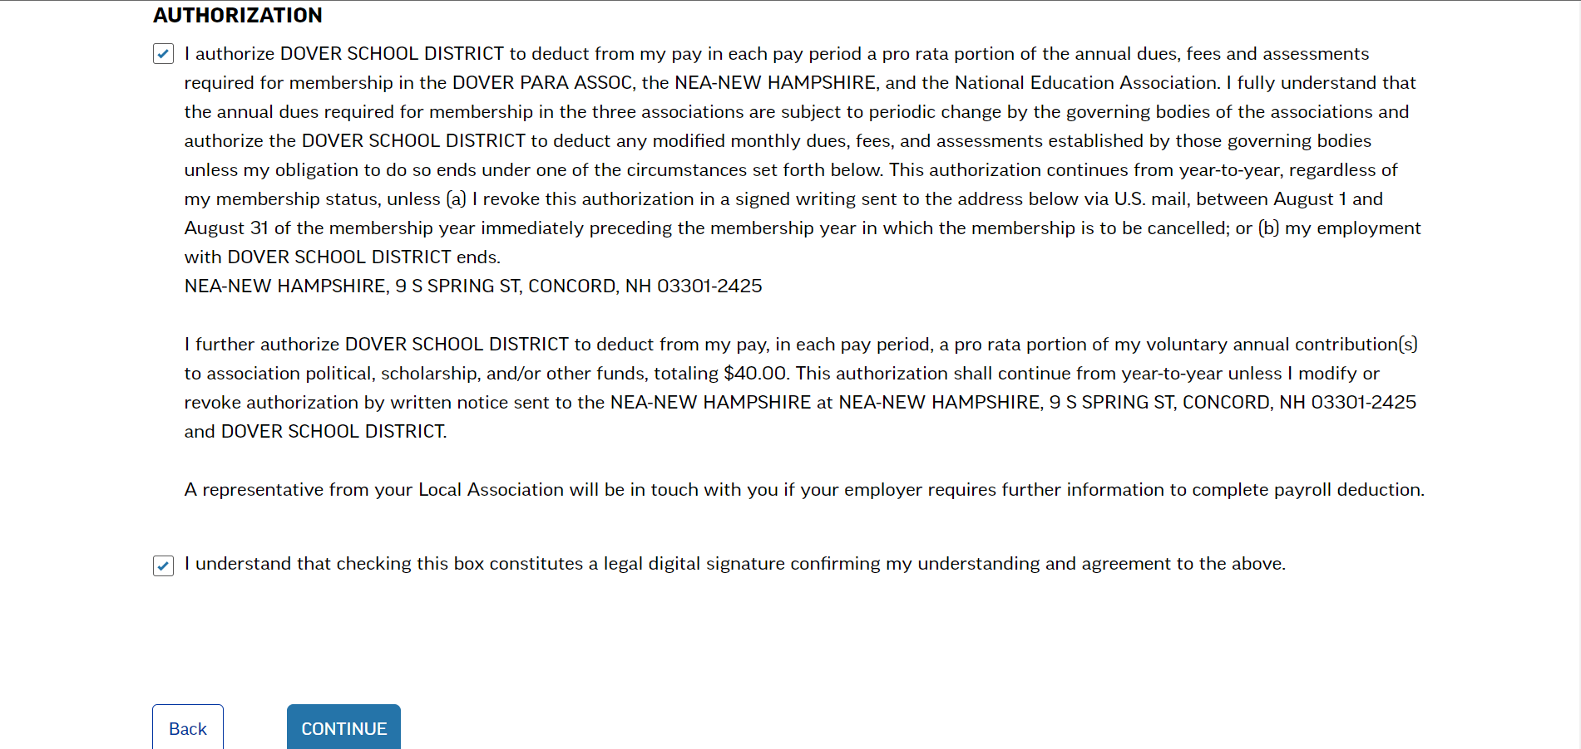
PAYROLL DEDUCTION PAYMENT METHOD: AUTHORIZE PAYROLL DEDUCTION
Notes:
By checking both Payroll deduction disclaimer boxes, the new member is authorizing the school district to make dues deductions. We know that there are employers that require a separate authorization form for payroll deduction, so NEA has added the highlighted statement to make the new member aware that further documentation might be needed. Check both boxes and hit CONTINUE.

Slide 25
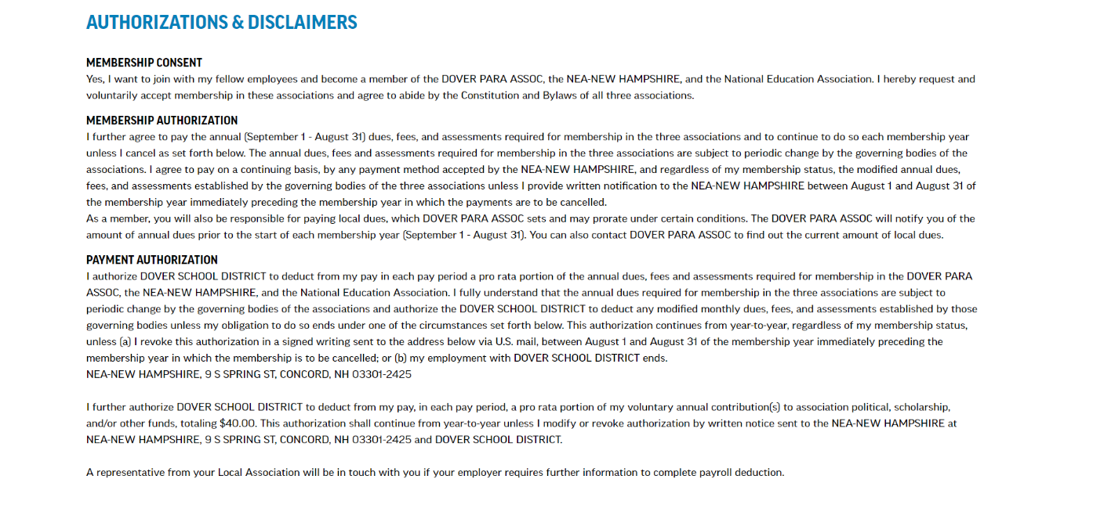
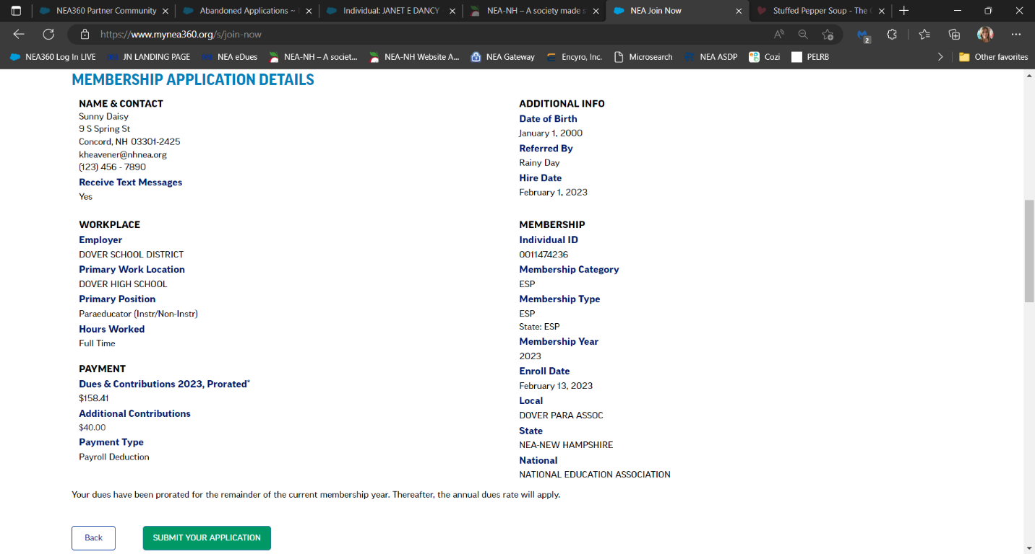
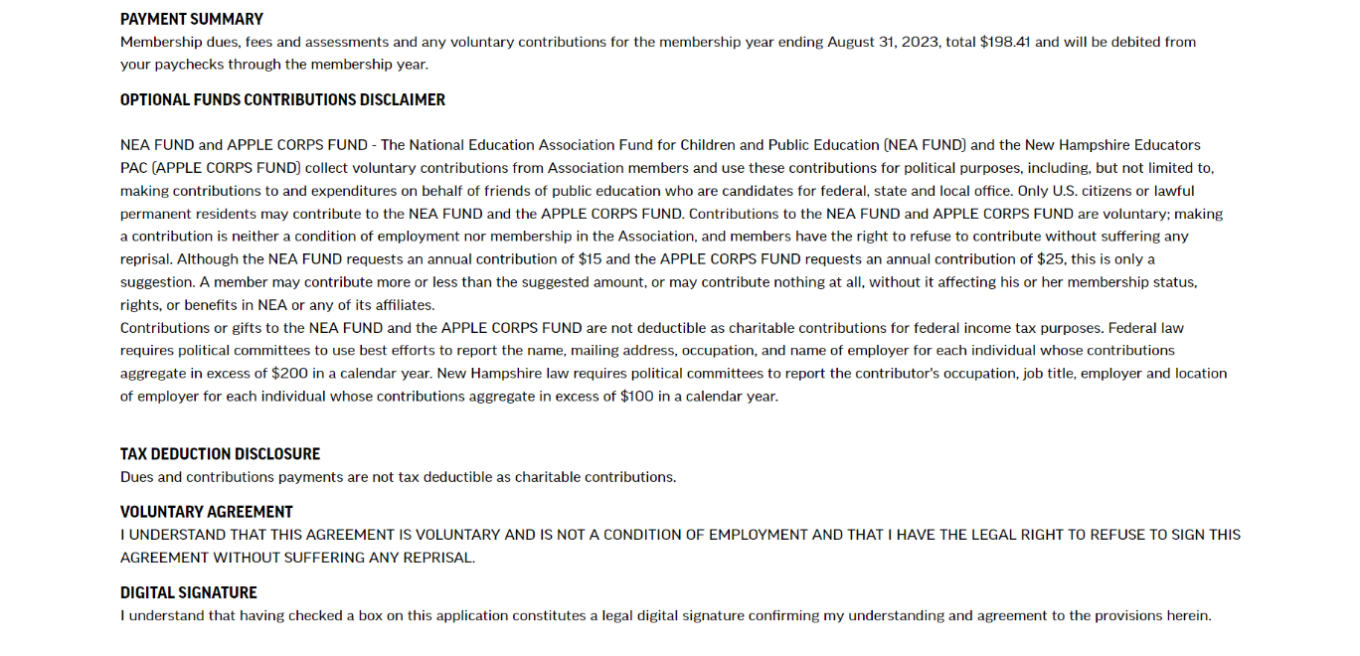
ALMOST FINISHED!
Notes:
This brings us to the Membership Review page. We are almost finished! All the information that has been entered and all disclaimers that have been accepted on the previous pages are put together here.

Slide 26
SUBMIT
YOUR APPLICATION!
Notes:
If everything looks correct, the new member will hit the green SUBMIT YOUR APPLICATION button or use the BACK button to make any needed corrections. They will have the opportunity to print a copy of their membership details and disclaimers at the next screen.

Slide 27
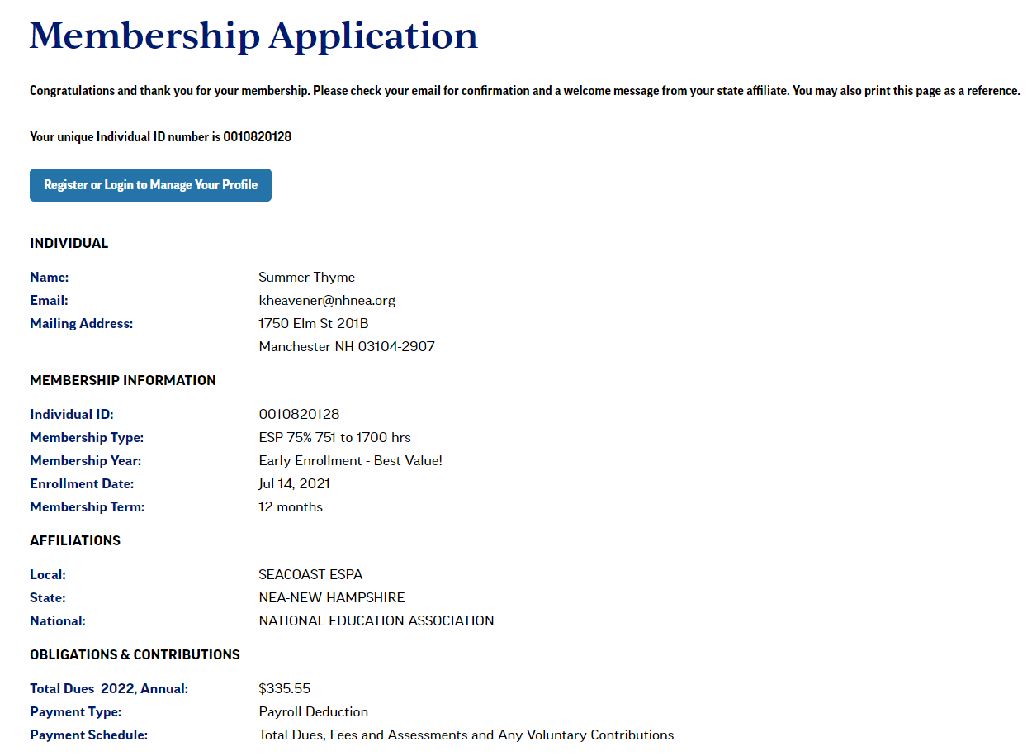
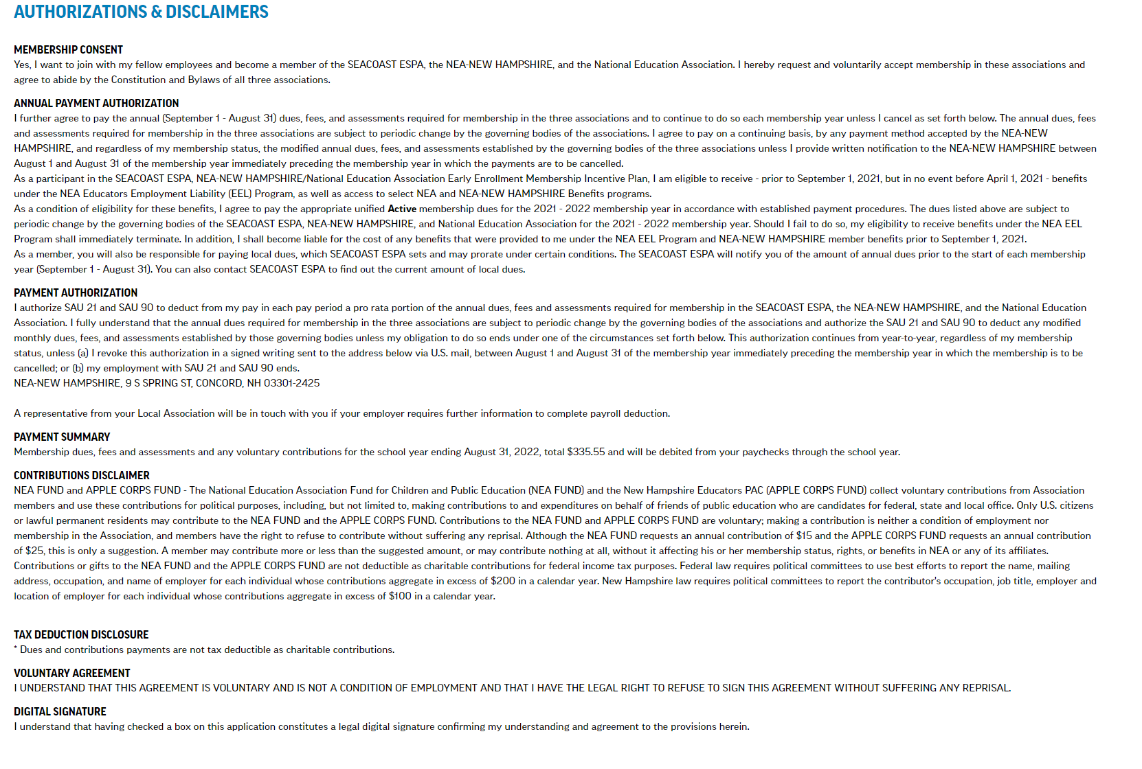
CONGRATULATIONS! YOU ARE A MEMBER!
Notes:
After submitting the application, the new member will see a “CONGRATULATIONS” message on the next page. They can print this page for their records, as it has all their membership information, including their Member ID number and the disclaimers they agreed to.

Slide 28
WELCOME EMAIL
Notes:
Within approximately 10 to 15 minutes, the new member will receive a confirmation email. If they do NOT receive an email, it is possible that they missed the “SUBMIT YOUR APPLICATION” button and the membership is not complete. Please let the UniServ Assistant for your region know so they can research the issue.
The email the new member receives will look similar to this example. It will have a short welcome and then a recap of all the information that was on the congratulations page, including the Member ID number and disclaimers. Your UniServ Assistant also gets a copy and will forward to the local this same confirmation email. The local will treat this confirmation email just as they would any other hard copy of a membership form and distribute copies as needed (i.e. Payroll office, copy for the local to keep). The new member will NOT need a copy because they receive the email when they join.
We suggest reaching out to your new member to personally welcome them to your local association and to introduce them to your officers and building reps. Remember to also let them know the amount of your local dues and your process for collecting it.

Slide 29
Tara Couture – Capital and Monadnock Regions
tcouture@nhnea.org
Direct: (603) 715-9502
Paula Gailing – Eastern and Seacoast Regions
pgailing@nhnea.org
Direct: (603) 715-9302
Ally Snyder - Lakes Region
asnyder@nhnea.org
Direct: (603) 715-9316
Kris Fessenden - North Country and Western Regions
kfessenden@nhnea.org
Direct: (603) 715-9309
Karen Heavener - South Central Region
kheavener@nhnea.org
Direct: (603) 715-9311
Liz Schneible - Southern Region
eschneible@nhnea.org
(603) 715-9505
HOW TO CONTACT YOUR UNISERV ASSISTANT
Notes:
Thank you for using Join Now. If you have any questions, please contact the NEA-New Hampshire UniServ Assistant for your region.

Slide 30
THANK YOU!
Karen Heavener
Liz schneible
NEA-NEW HAMPSHIRE

